Slide 1
ECE 884 Deep Learning
Lecture 3: Machine Learning Basics - 2
01/26/2021

Slide 2
Logistics
Slack workspace
Google sheet
Final project:
Our goal: submit a poster to top-tier academic conferences.
To identify the topic of your project, do a thorough literature review.
Think about novelty: how your idea is different from existing ones.
Think about impact: how your idea would advance the state of the art.

Slide 3
Review of last lecture
What is Machine Learning?
Supervised Learning Pipeline
Features
Hypothesis Space of the function
Types of Data Sets: training vs. testing

Slide 4
Today’s lecture
Other flavors of machine learning

Slide 5
Supervised Learning
Given inputs (data-label pairs), learn a model to predict output
Labeled data is available
Labeled data is clean (classification problem)
No restrictions* on type of input and labels

Slide 6
Unsupervised Learning
Given just data as input (no labels), learn some sort of
underlying structure..
Goal is often vague or subjective (compared to supervised learning, where labels define the goals)
Also known as exploratory/descriptive data analysis
Credit: Lazebnik

Slide 7














Unsupervised Learning: Clustering
Discover groups of “similar” data points
Credit: Lazebnik

Slide 8






Unsupervised Learning: Quantization
Quantization or data compression
Encode the data into a more compact form
C₂
C₁
C₃
Credit: Lazebnik

Slide 9
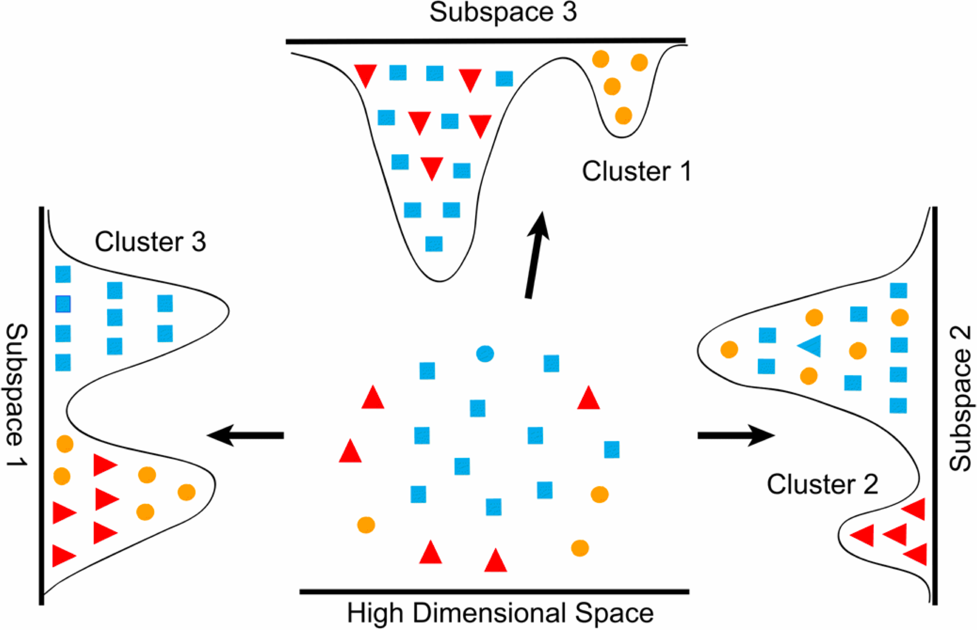
Unsupervised Learning: Dimensionality Reduction
Dimensionality reduction, manifold learning
Discover a lower-dimensional surface on which the data lives
Credit: Lazebnik, Image source1, source2

Slide 10
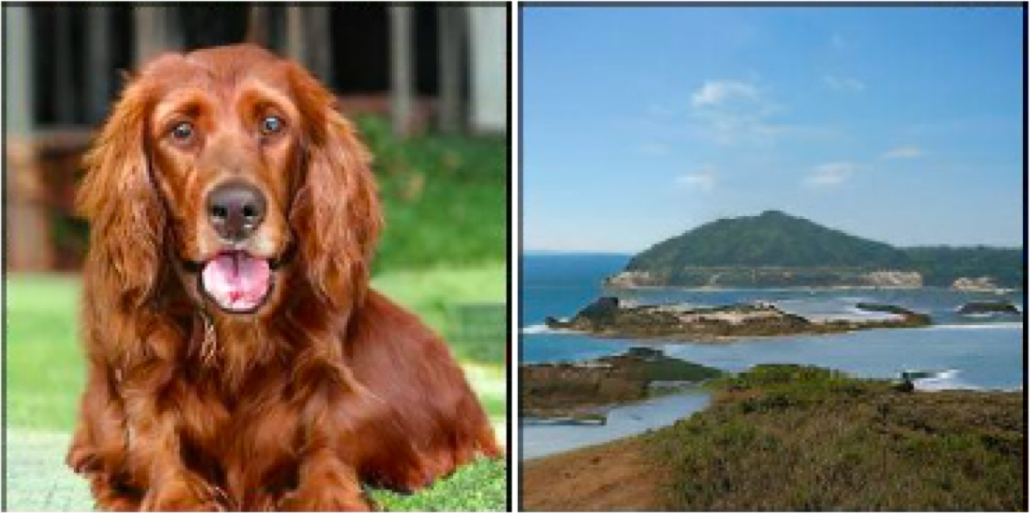
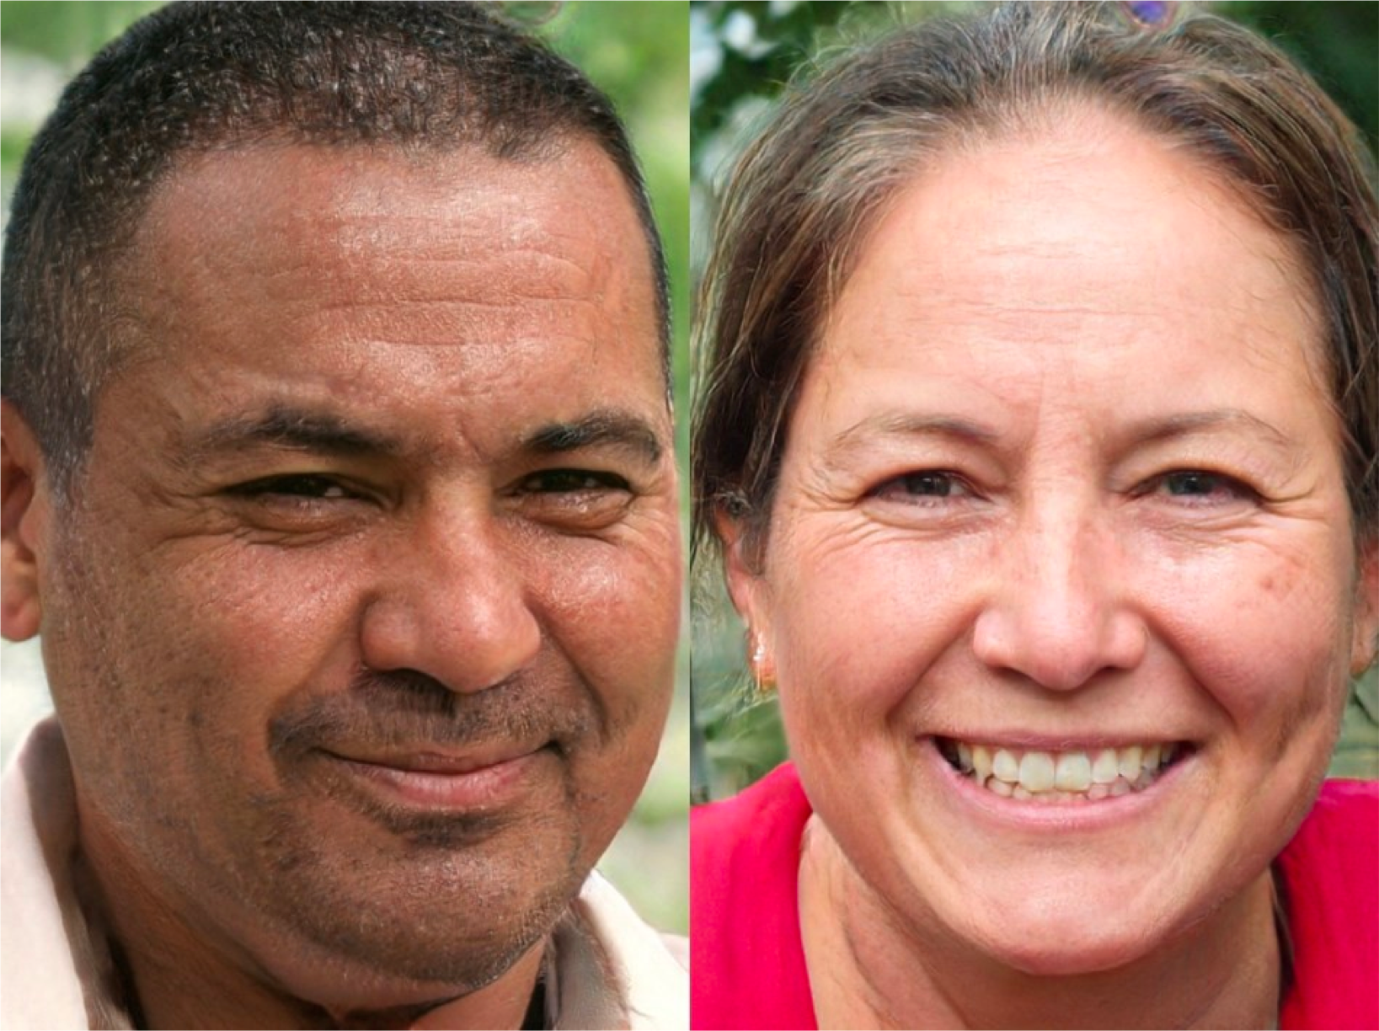
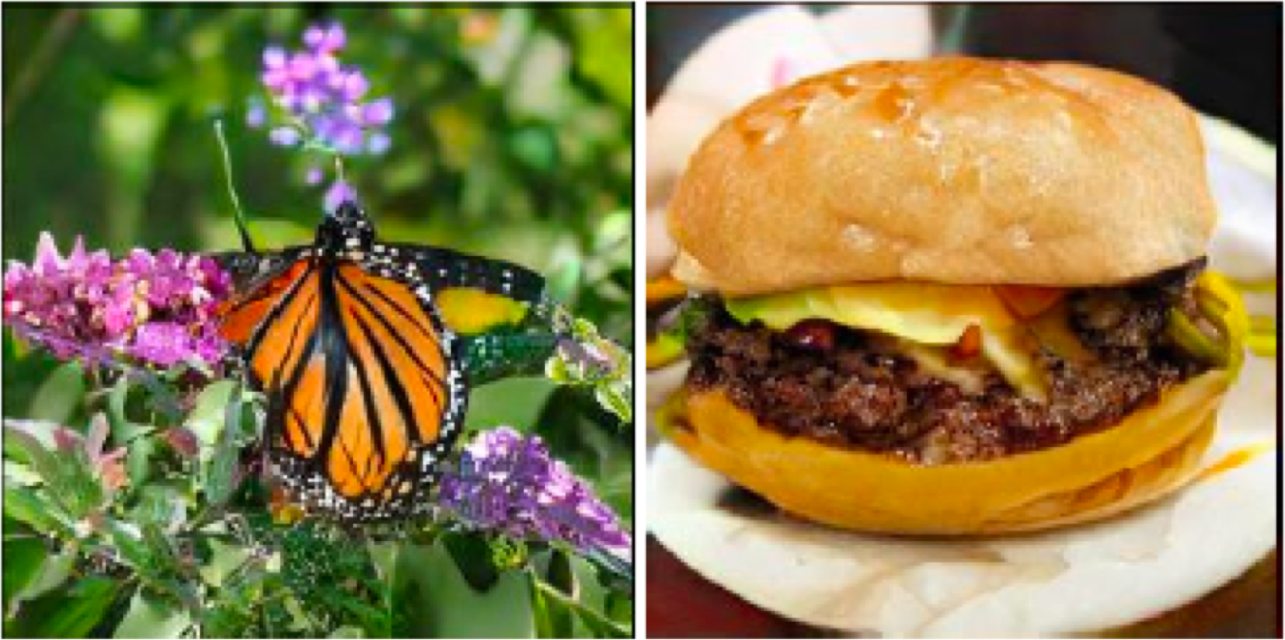
Unsupervised Learning: Learning Data Distribution
Learning to sample (e.g., GANs or Generative Adversarial Networks)
Produce samples from a data distribution that mimics the training set
Credit: Lazebnik, Image DeepMind’s BigGAN, NVIDIA GAN

Slide 11
Extremes of Learning Paradigms
Supervised Learning
Unsupervised Learning
Needs nice, clean labels
All data needs to be labeled
Labels correspond to task of interest
No labels
No labels
How does this work?

Slide 12

Semi-supervised Learning (SSL)
Figure credit: UCL slides

Slide 13

Semi-supervised Learning (SSL)
Figure credit: UCL slides

Slide 14

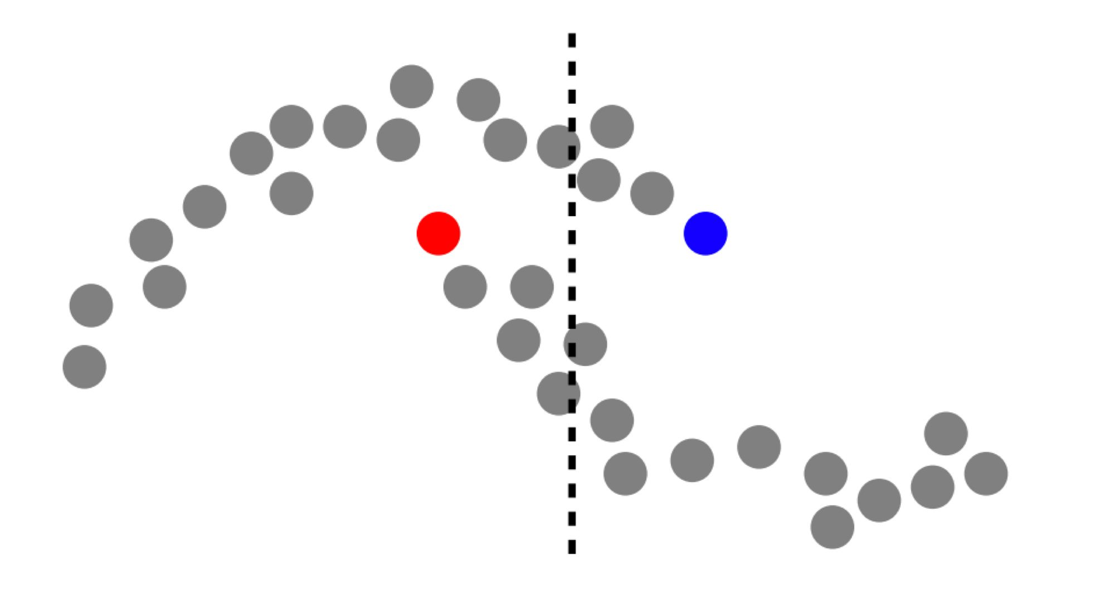
Semi-supervised Learning (SSL)
Figure credit: UCL slides

Slide 15
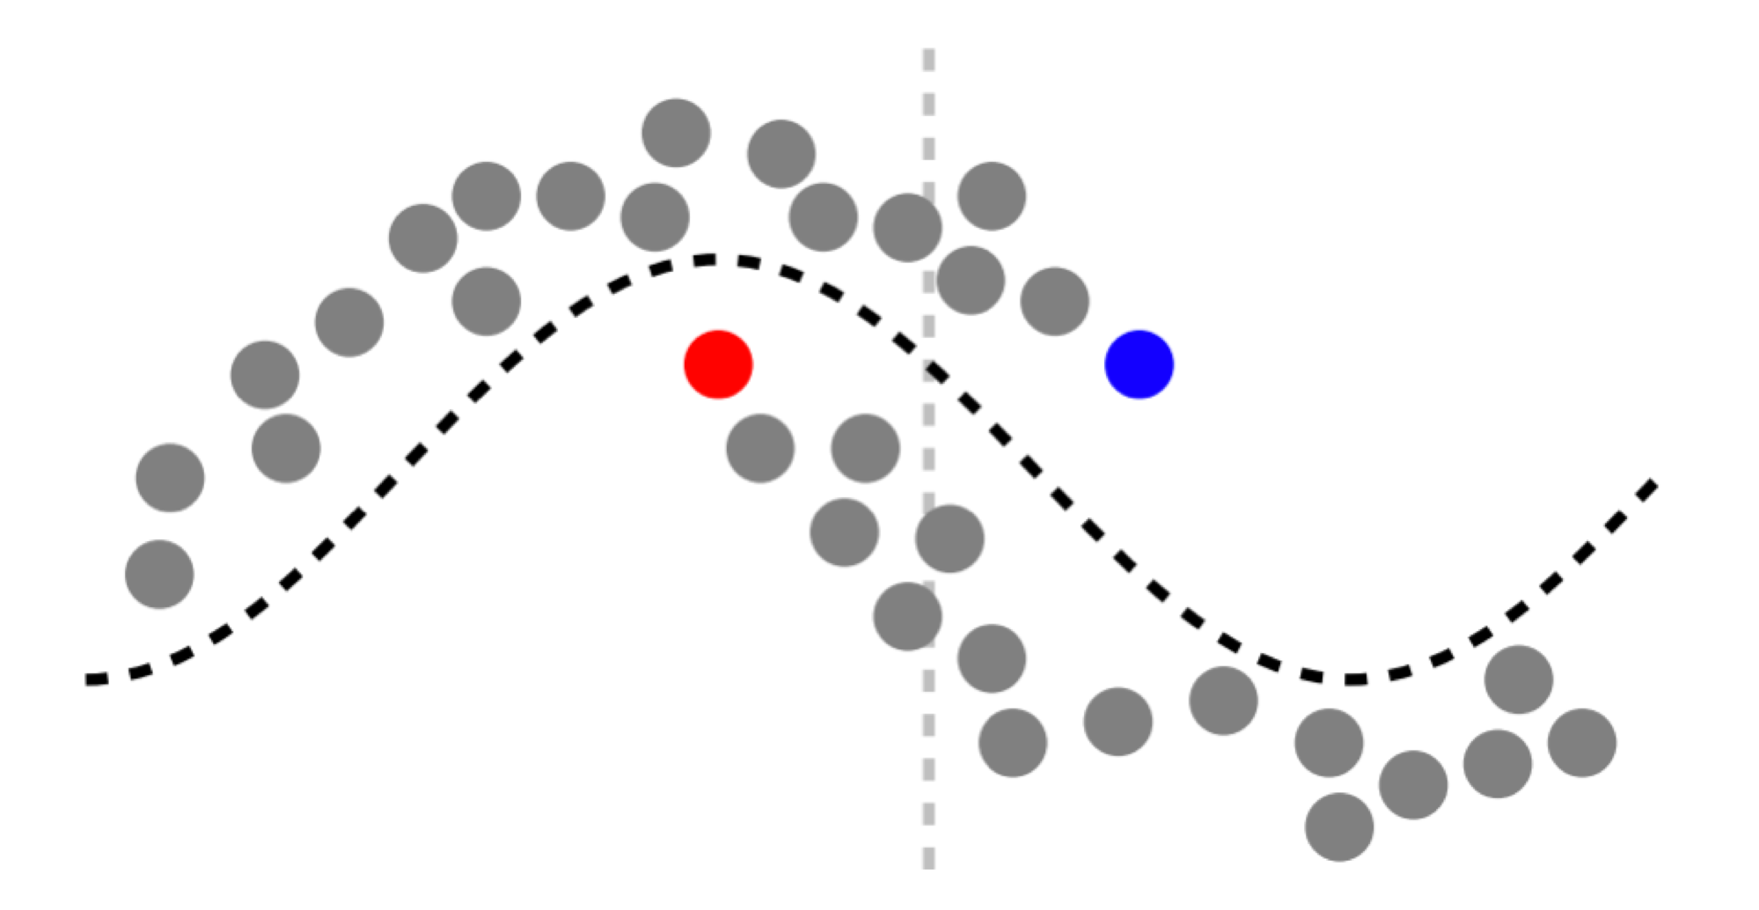
Semi-supervised Learning (SSL)
Figure credit: UCL slides

Slide 16
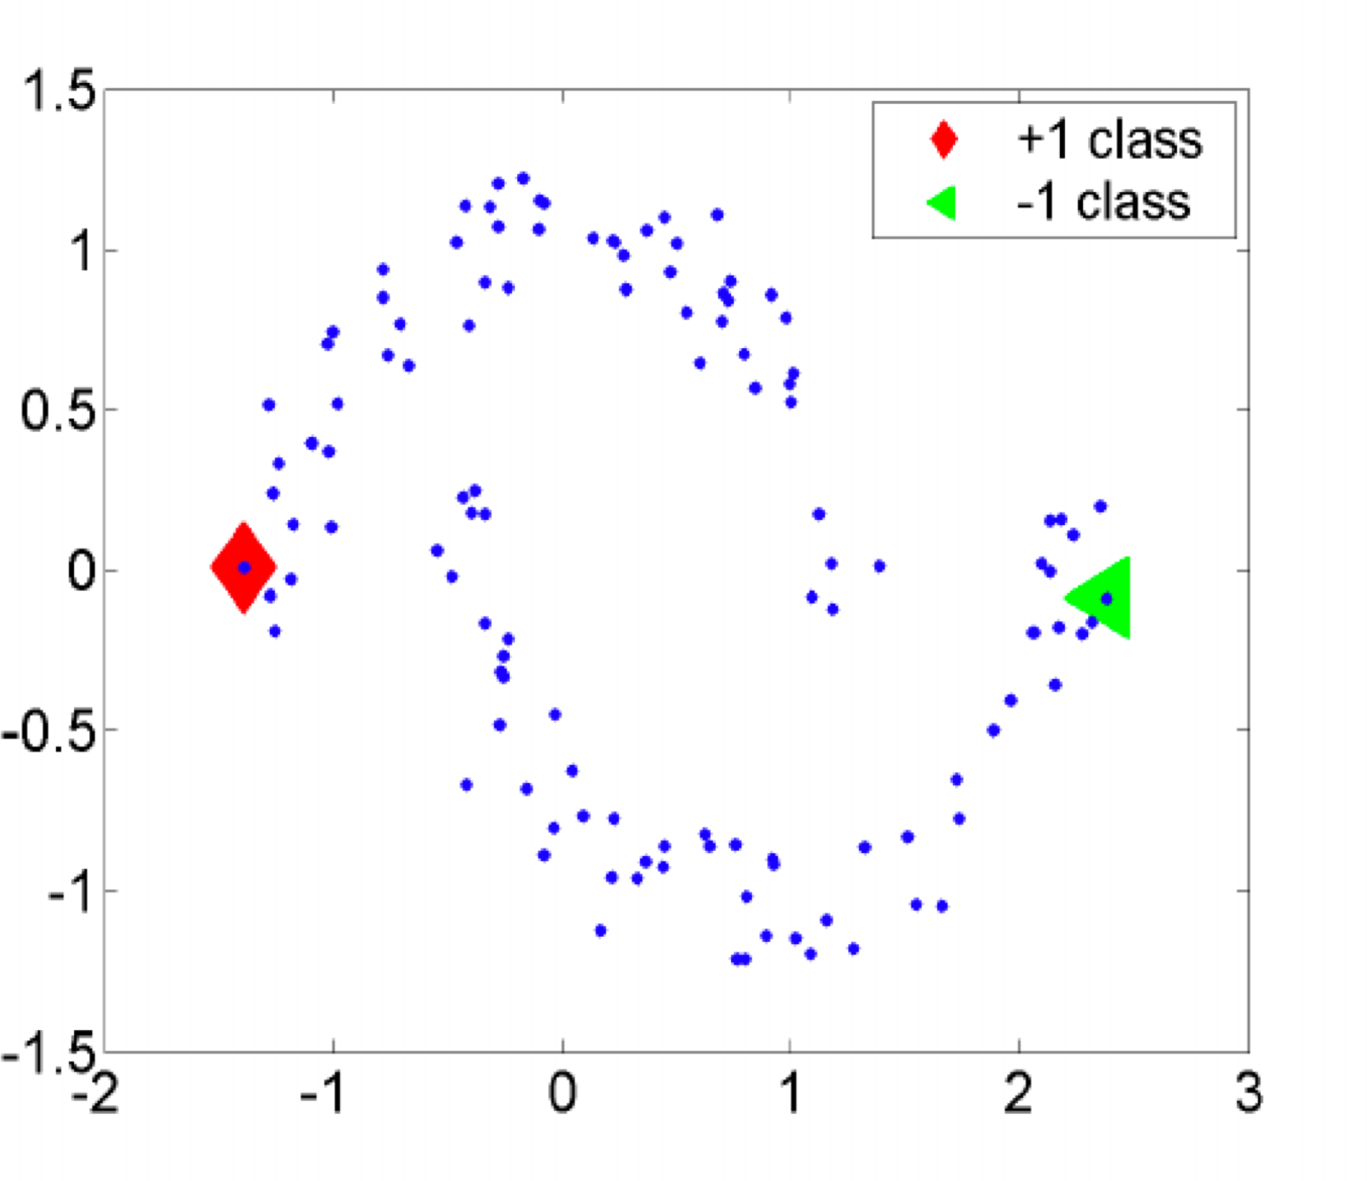
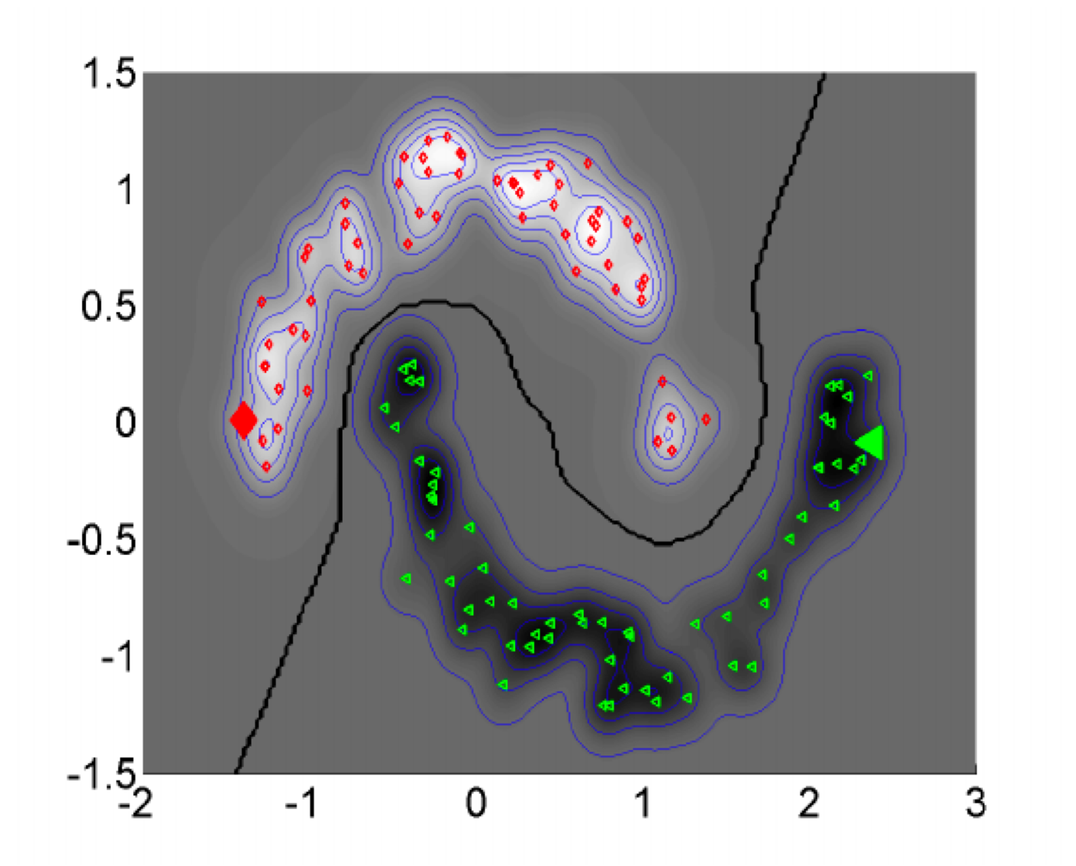
Semi-supervised Learning (SSL)
Figure: source

Slide 17
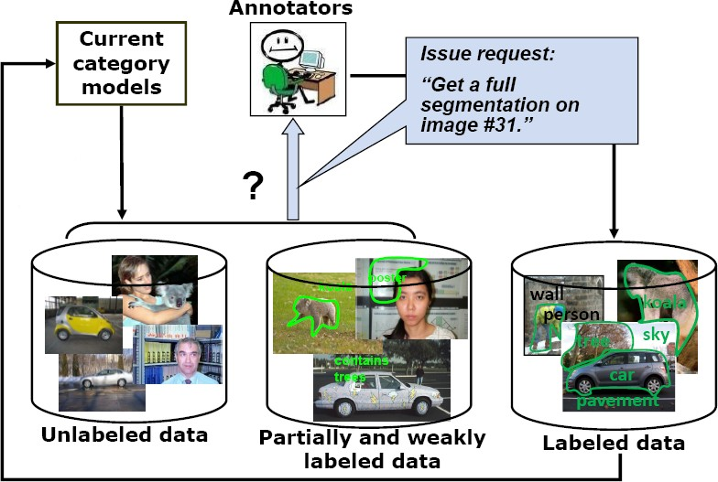
Active Learning
Human in the loop to ask questions/labels
Credit: Lazebnik, Figure: source

Slide 18
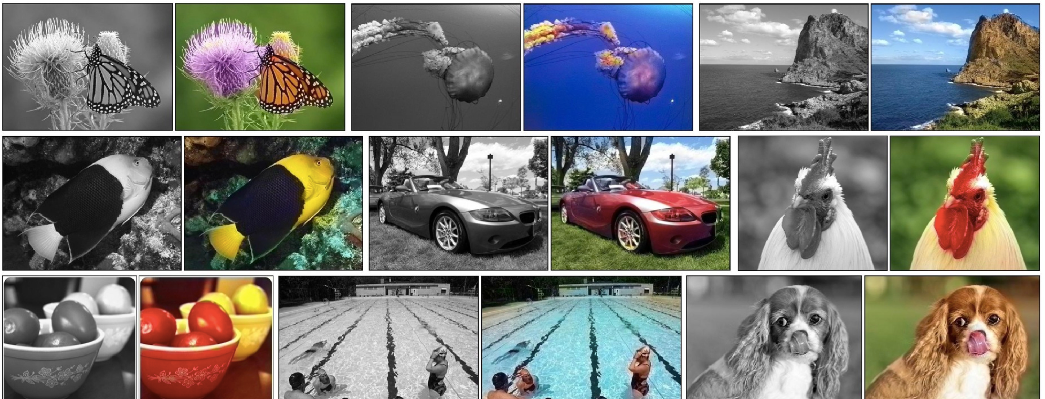
Self-supervised Learning
Proxy-tasks (e.g., image colorization):
Use supervision naturally arising from data
No human provided labels
Credit: Lazebnik, Figure: source

Slide 19
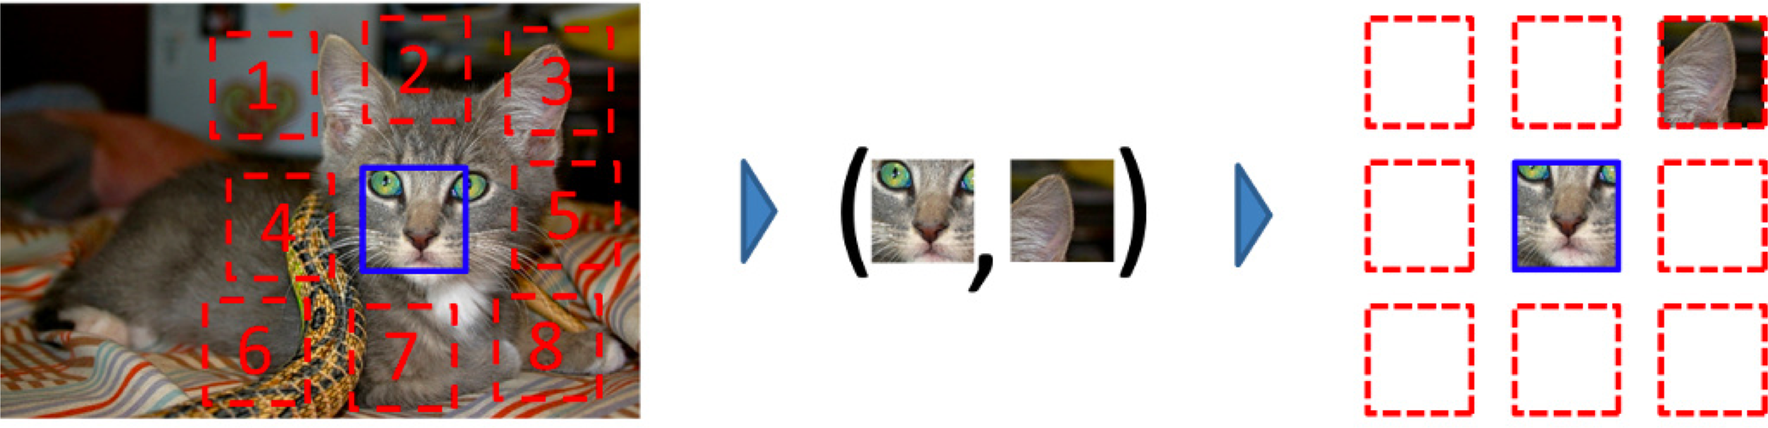
Self-supervised/Predictive Learning
Proxy-tasks (e.g., context prediction):
Use supervision naturally arising from data
No human provided labels
Figure: source

Slide 20
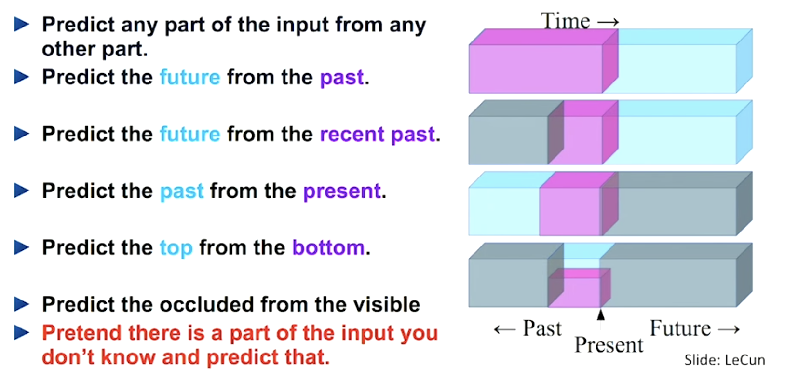
Self-supervised/Predictive Learning
Natural Language Processing

Slide 21
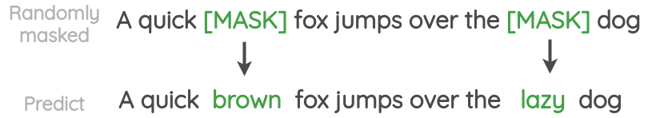
Self-supervised/Predictive Learning
Natural Language Processing

Slide 22

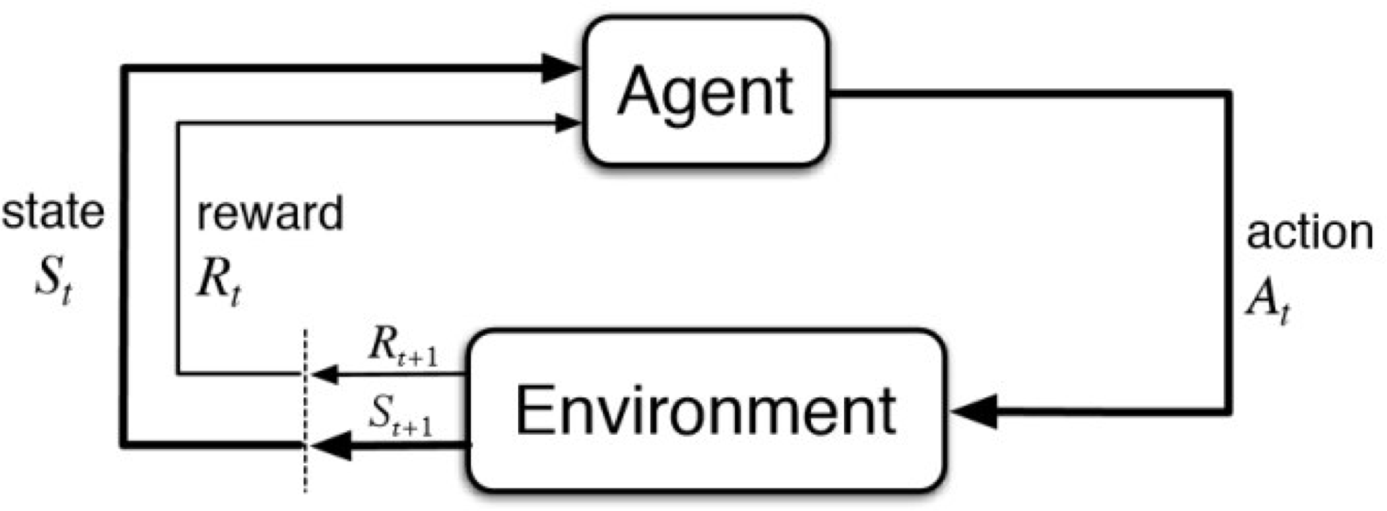
Reinforcement Learning
Learn in an interactive environment by sequential trial and error using feedback/rewards from its own actions and experiences
Figure source1, source2

Slide 23
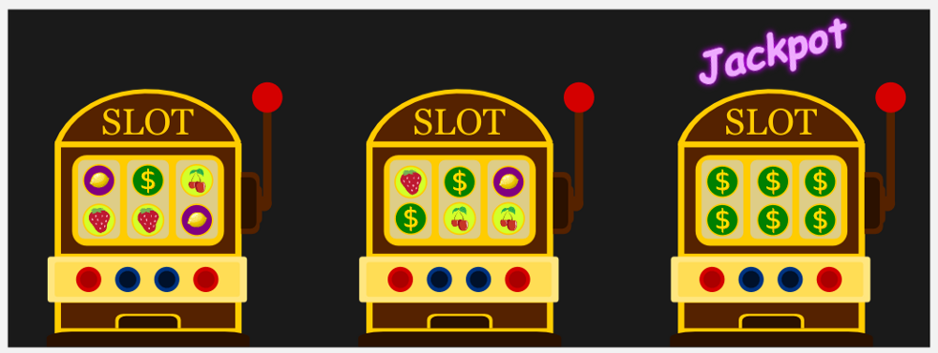
Reinforcement Learning
Multi-arm Bandit

Slide 24
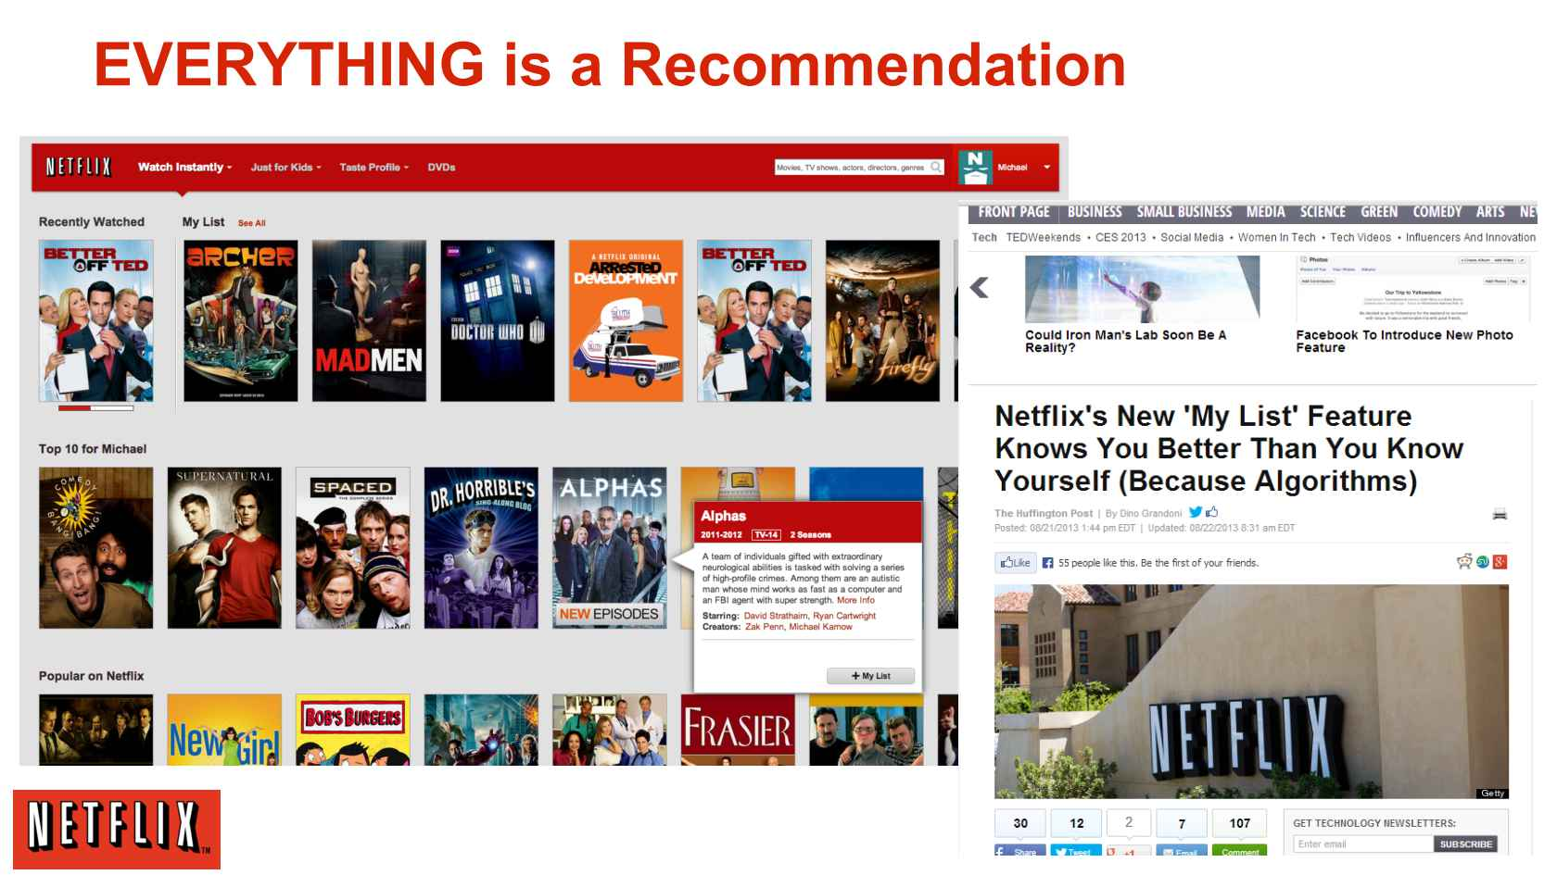
Reinforcement Learning
Recommendation Systems

Slide 25
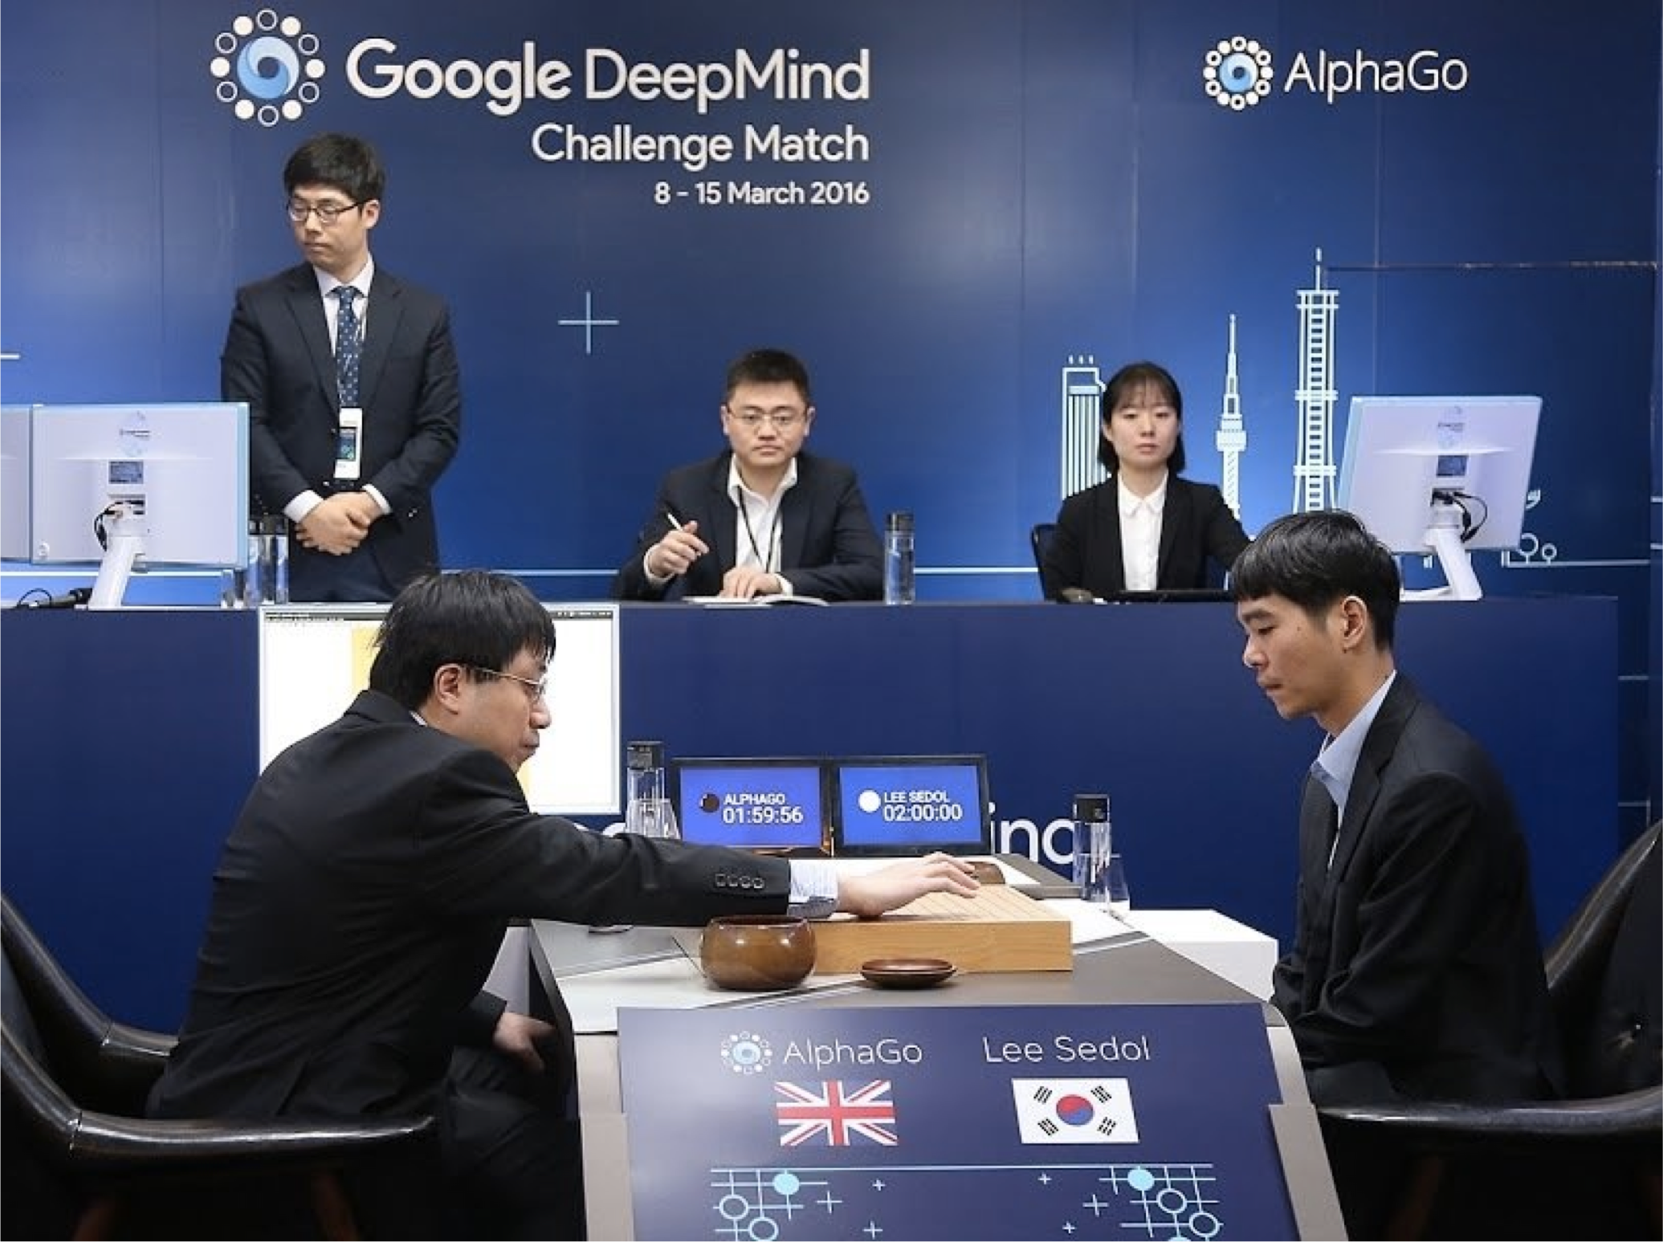
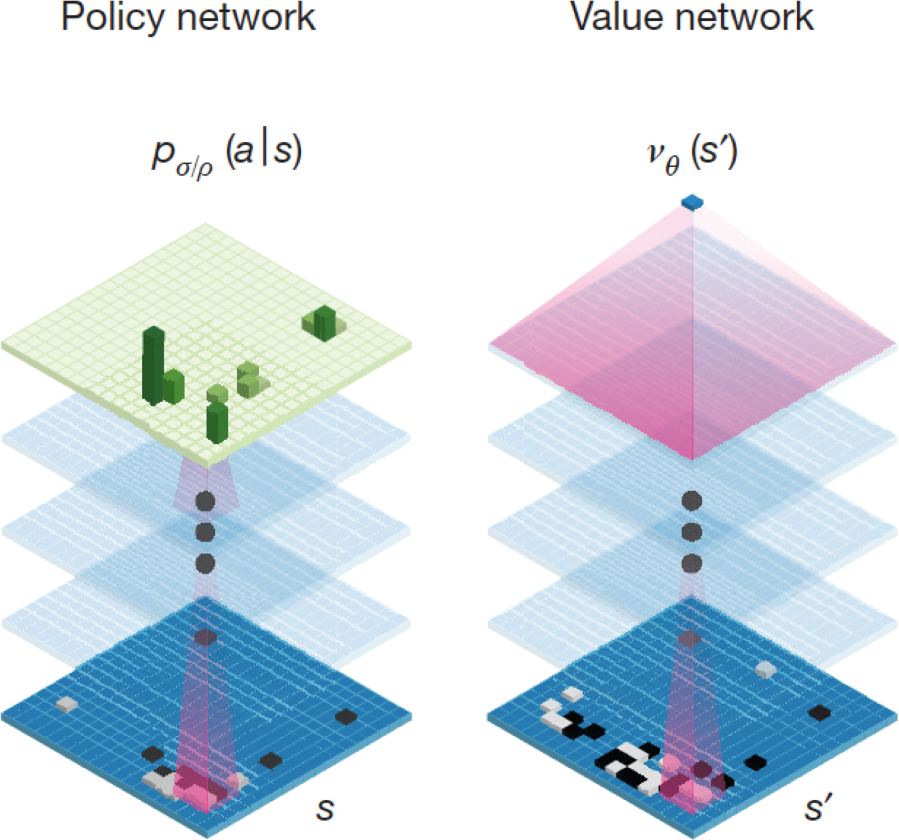
Reinforcement Learning
Go game
Credit: Lazebnik, AlphaGo

Slide 26
Focus of this Course
Supervised Learning

Slide 27
Any Question ?

